Slide 1
Introduction to HTML
Vincci Kwong
Reference/Instruction Librarian

Slide 2
What is HTML?
Hyper Text Markup Language
A markup language designed for the creation of web pages and other information viewable in a browser
The basic language used to write web pages
File extension: .htm, .html
Notes:
A little bit history about hypertext. Originated from Vannevar Bush, hypertext is an idea of linking documents together to make it easier to keep track of relationships between documents. The concept is more focus on individual, instead of a global system linking documents from many sources.

Slide 3
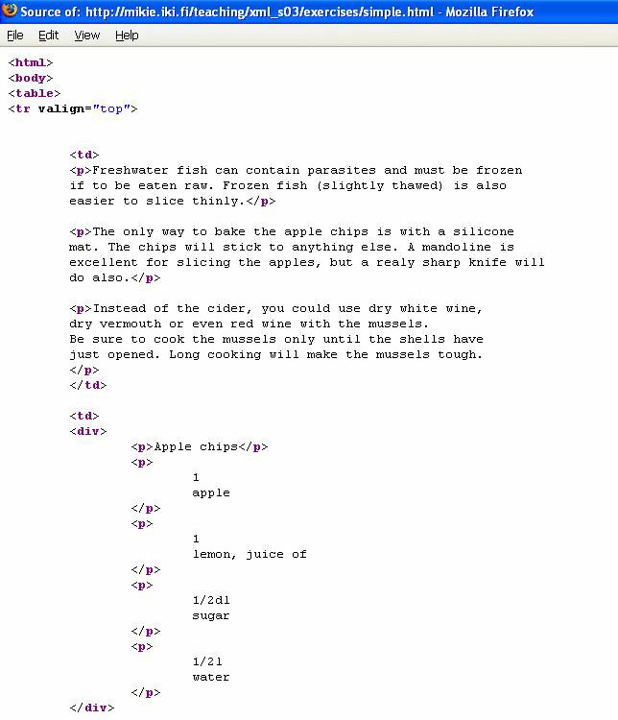
How is a HTML File Looks Like

Slide 4
Creating a HTML File
Open Notepad
Click on File -> Save as…
In the File name pull-down box, type in webpage.html
Click on Save
Type in content for your file
Once you finished the content, click on File -> Save

Slide 5
HTML Tags
For example: <b>, <font>,<title>, <p> etc.
Tag usually goes with pair: an open tag (<b>) and an end tag (<\b>)
Single tag: <hr>,<br>
Tags are NOT case sensitive
Effect | Code | Code Used | What It Does
Bold | B | <B>Bold</B> | Bold
Italic | I | <I>Italic</I> | Italic
Notes:
HTML documents contain content that is to be displayed and tags that define the structure of the document (and in a few cases to specify formatting instructions). These tags are used by a browser to decide how to display the content. HTML documents are simple text files that can be created with any text editor, the tags are just special sequences that provide information to the browser on how to display them. HTML tags are always bracketed within a less-than (<) and greater-than (>) character. Every tag has a name that indicates to the browser some information about document structure, and some tags can have attributes that provide additional information to the browser.

Slide 6
HTML Document Structure
<html>
<head>
<title> Page Title Goes Here </title>
</head>
<body>
content goes here
</body>
</html>
Notes:
Every HTML document should start with the tag <html> and end with the tag </html>, this tells the browser that this is an HTML document. Each HTML document includes a head and a body. The head includes information about the document (possibly the title, author, date of creation, software used to create the document) and the body contains the content of the document. There are tags used to identify these sections:
<head> </head> these tags surround the head of the document and come first (before the body tags).
<body> </body> these tags surround the content of the document.
The head and body tags are actually required by the latest version of HTML. Within the title tags the document should contain a document title - this title is typically shown in the title bar of the browser window. Document titles should convey something useful about the content of the document.

Slide 7
Background
Bgcolor
Specifies a background-color for a HTML page.
<body bgcolor="#000000"> <body bgcolor="rgb(0,0,0)"> <body bgcolor="black">
Background
Specifies a background-image for a HTML page
<body background="clouds.gif">
<body background="http://www.w3schools.com/clouds.gif">

Slide 8
Text
Put text on a webpage
  <p>Today is my first day at my new job, I’m so excited!</p>
  Output: Today is my first day at my new job, I’m so excited!
Put text in center of a page
  <center>Hello</center>
  Output: Hello
Put text on the right of a page
  <p align=“right”>Hello</p>
  Output: Hello

Slide 9
Font
To change text size
  <font size=“+3”>Hello</font>
  Output: Hello
To change text color
  <font color=“red”>Hello</font>
  Output: Hello
Using both
  <font size=“+3” color=“red”>Hello</font>
  Output: Hello
Tag attribute
Notes:
Tags can have attributes. Attributes can provide additional information about the HTML elements on your page.
Attributes always come in name/value pairs like this: name="value".
Attributes are always added to the start tag of an HTML element

Slide 10
Commonly Used Character Entities
Result | Description | Entity Name
 | Non-breaking space | &nbsp;
< | Less than | &lt;
> | Greater than | &gt;
& | Ampersand | &amp;
“ | Quotation mark | &quot;
© | Copyright | &copy;
Notes:
Some characters have a special meaning in HTML, like the less than sign (<) that defines the start of an HTML tag. If we want the browser to actually display these characters we must insert character entities in the HTML source.

Slide 11
Headings
There are 6 heading commands.
<H1>This is Heading 1</H1>
<H2>This is Heading 2</H2>
<H3>This is Heading 3</H3>
<H4>This is Heading 4</H4>
<H5>This is Heading 5</H5>
<H6>This is Heading 6</H6>
Notes:
A number of tags are defined to be used to indicate section headings within a document. Typically a document contains a number of sections (chapters), and within each section are subsections, and within subsections are sub-subsections, and so on. The heading tags are <h1>, <h2>, <h3>, ... <h6>, with H1 being the highest level heading (usually rendered the largest) and H6 the lowest level heading.

Slide 12
List
Unordered list
  Code:
  <ul>
  <li>Coffee</li> <li>Milk</li>
  </ul>
  Output:
    Coffee
    Milk
Ordered list
  Code:
  <ol>
  <li>Coffee</li> <li>Milk</li>
  </ol>
  Output:
    Coffee
    Milk
Notes:
HTML supports ordered (numbered) and unordered lists. Each list can include a number of list items, the browser renders these list items in a way that (hopefully) appears as a list.
Unordered lists are contained within the tags <ul> and </ul>. Ordered lists are contained within the <ol> and </ol> tags. In both cases each individual list item is contained within the <li> and </li> tags.

Slide 13
Table
<table border=“1">
<tr>
<th>Heading</th>
<th>Another Heading</th>
</tr>
<tr>
<td>row 1, cell 1</td>
<td>row 1, cell 2</td>
</tr>
<tr>
<td>row 2, cell 1</td>
<td></td>
</tr>
</table>
Heading | Another Heading
Row 1, cell 1 | Row 1, cell 2
Row 2, cell 1
Notes:
HTML supports the display of tabular data using tables. Tables are also used to manage document layout (probably more often than to display tabular data). The HTML table model includes three basic elements - the table ( <table> and </table> tags), table row ( <tr> and </tr> tags) and a table cell (using either <th>,</th> or <td>,</td> tags).

Slide 14
Create Links
A Hypertext link
  < a href=“http://www.iusb.edu”>IUSB Home</a>
  Output: IUSB Home
A Email link
  <a href=“mailto:vkwong@iusb.edu”>
  Email me</a>
  Output: Email me
Notes:
Creation of a Hyperlink is done with the <a>,</a> tags. The text between the <a> and </a> tags becomes the link - when a user clicks on this text the browser open a new document. The location and name of the new document (the destination of the link) is included in the <a> tag as the value of the HREF attribute. This value is specified as a URL.

Slide 15
Image Formats
.gif
  Graphics Interchange Format
.jpeg or .jpg
  Joint Photographic Experts Group
.bmp
  bitmap

Slide 16

Inserting Image
Place all images in the same directory/folder where you web pages are
<img src> is a single tag
<img src=“image.gif”>
  Output:
Turn an image into a hyerlink
  <a href=“http://www.iusb.edu”><img src=“image.gif”></a>
  Output:

Slide 17

Image Size
Computer images are made up of “pixels”
<IMG HEIGHT=“100" WIDTH=“150" SRC="image.gif">
Height
Width

Slide 18
Forms
A form is an area that can contain form elements.
<form></form>
Commonly used form elements includes:
  Text fields
  Radio buttons
  Checkboxes
  Submit buttons
Notes:
Many Web applications require that a user to provides some input. Typically a user fills out a form by filling in some fields with text and/or selecting from lists of options. HTML forms provide a mechanism for including many input boxes (and buttons) that the user can use to provide input to a web application.

Slide 19
Text Input Fields
Used when you want the user to type letters, number, etc.
<form>
First name: <input type="text" name="firstname">
<br>
Last name: <input type="text" name="lastname"> </form>
Output
First name:
Last name:
Notes:
TEXT is the most common type of input field, it allows the user to type in a single line of text. There are some additional attributes that can control the maximum length of the field (MAXLENGTH).

Slide 20
Submission Button
When user clicks on the “Submit” button, the content of the form is sent to another file.
<form name="input" action="html_form_action.asp" method="get"> Username: <input type="text" name="user">
<br>
<input type="submit" value="Submit">
</form>
Output
Username:
Notes:
Another type of input field is the SUBMIT type, this tells the browser to draw a button. When the user clicks on the button the browser knows to submit the contents of the form to the URL specified as the ACTION in the form tag.
Submit inputs support the attribute VALUE which is the string you want displayed in the button. If you don't include a VALUE attribute the browser will put the string "Submit" in the button. Note that the NAME attribute is not required for a submit input.

Slide 21
Checkboxes
Used when you want the user to select one or more options of a limited number of choices.
<form>
<input type="checkbox" name="bike“ value=“bike”> I have a bike
<br>
<input type="checkbox" name="car“ value=“car”> I have a car </form>
Output
I have a bike
I have a car
Notes:
Inputs of type CHECKBOX present user with an item that can be selected or deselected. Each checkbox has a name and a value and can be initially selected/deselected.

Slide 22
Radio Buttons
Used when you want the user to select one of a limited number of choices.
<form>
<input type="radio" name="sex" value="male"> Male
<br>
<input type="radio" name="sex" value="female"> Female </form>
Output
Male
Female
Notes:
Radio Button inputs are like checkboxes, except that the user must select only one item from group of choices.

Slide 23
Text Box
Used when you want to get input from user.
<form>
<p>Please provide your suggestion in the text box below:</p>
<textarea row=“10” cols=“30”>
</textarea>
</form>
Output
Please provide your suggestion in the text box below:
Notes:
You can create a multiline text field with the TEXTAREA tag. The TEXTAREA tag requires the NAME attribute and supports the attributes ROWS and COLS (to define the size of the box drawn on the screen). Unlike the INPUT tag - the TEXTAREA tag has an end tag, so you need to include a </TEXTAREa> tag.

Slide 24
Pull-down Menu
Used when you want user to respond with one specific answer with choices you given.
<p>Select a fruit:</p> <select name"Fruit">
<option selected> Apples
<option> Bananas
< option > Oranges
</select>
Output
Select a fruit:
Notes:
The SELECT and OPTION tags can be used to create pull-down menus and scrolling lists of choices. The SELECT tag must include a NAME attribute (this is the name of the form field sent by the browser). Between the <SELECT> tag and the corresponding end tag </SELECT> there can be number of OPTION tags - one for each choice you want displayed. The text that follows the OPTION tag is the text that will be displayed by the browser. The value sent by the browser if a choice is selected can be specified with a VALUE attribute, if none is specified the value sent will be the text that follows the OPTION tag.

Slide 25
Additional Resource
http://www.w3schools.com/html/default.asp

